Slide 1
Exploratory Data Analysis- Education report:2015-16 in India
PRESENTED BY: ASHIKA MERYL PINTO
SAMHITHA DINESH

Slide 2
Data Set: EDUCATION IN INDIA
The dataset chosen shows us a bird's-eye view of the education system in India. It has estimated values of the data from which we can deduce the education development taking place in the country.
890 columns and 618 rows.
The sole purpose of scrutinising this dataset is to procure sufficient information regarding the literacy of the country and to come up with efficient solutions to improve the same.

Slide 3
DATA CLEANING
Measures taken:
1.>Replacing missing values by he median of the respective columns
2.>Replacing invalid
3.>There are also some outliers in the data set. But we found it best to not replace

Slide 4
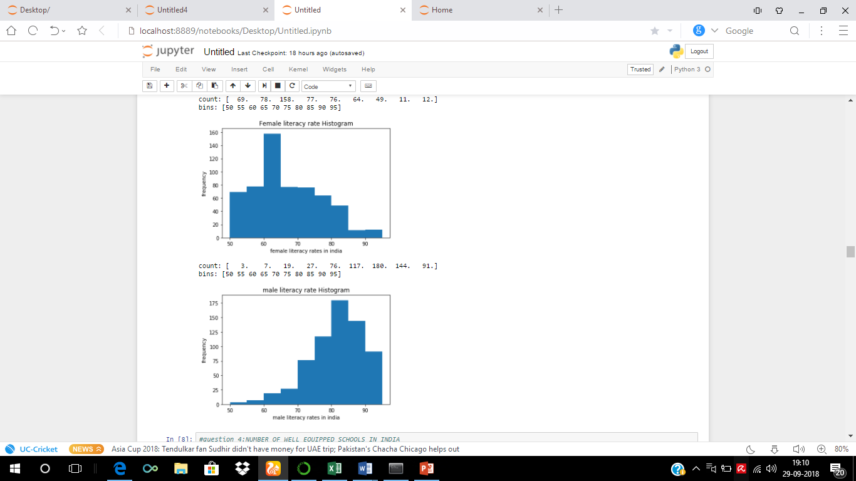
1.Literacy and Education of Women in India!

Slide 5
Low female literacy rate means an overall sluggish growth of India, as it impacts every arena of the development.
Kerala has the highest female literacy rate whereas Rajasthan has the lowest female literacy rate in India. States such as Uttar Pradesh and Bihar that are the most populated states in India show low levels of female literacy.

Slide 6
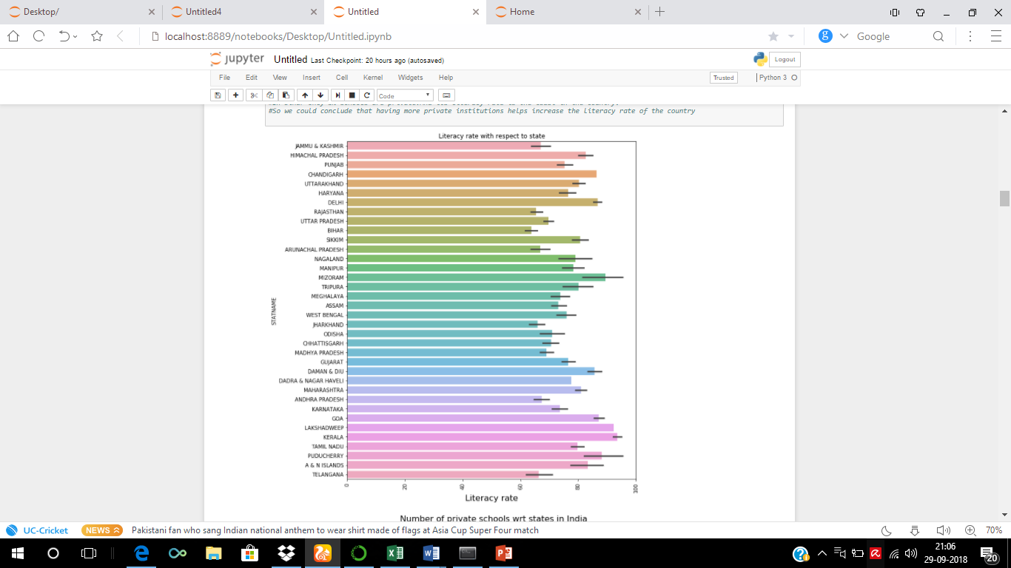
2.Higher number of private schools imply higher literacy rate

Slide 7
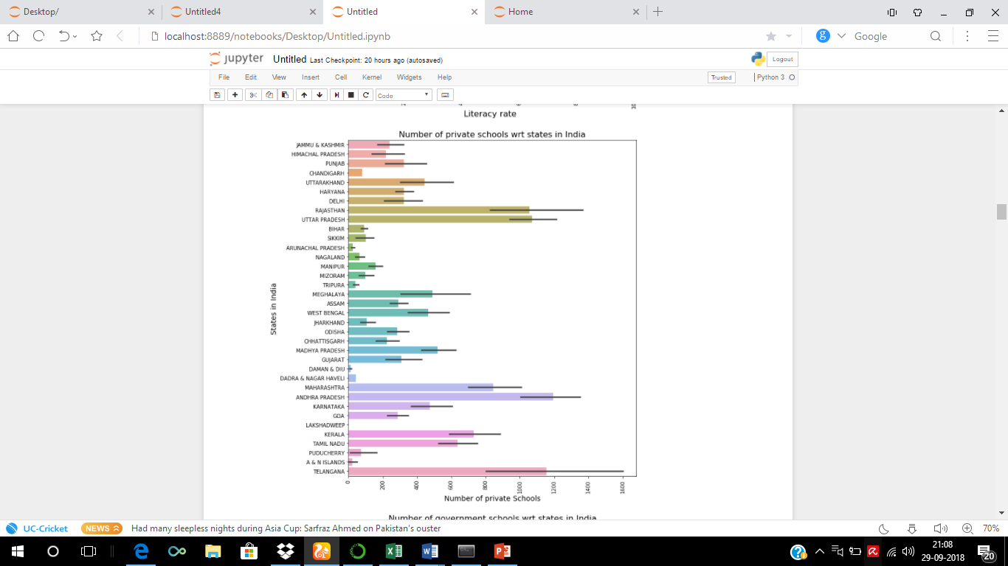
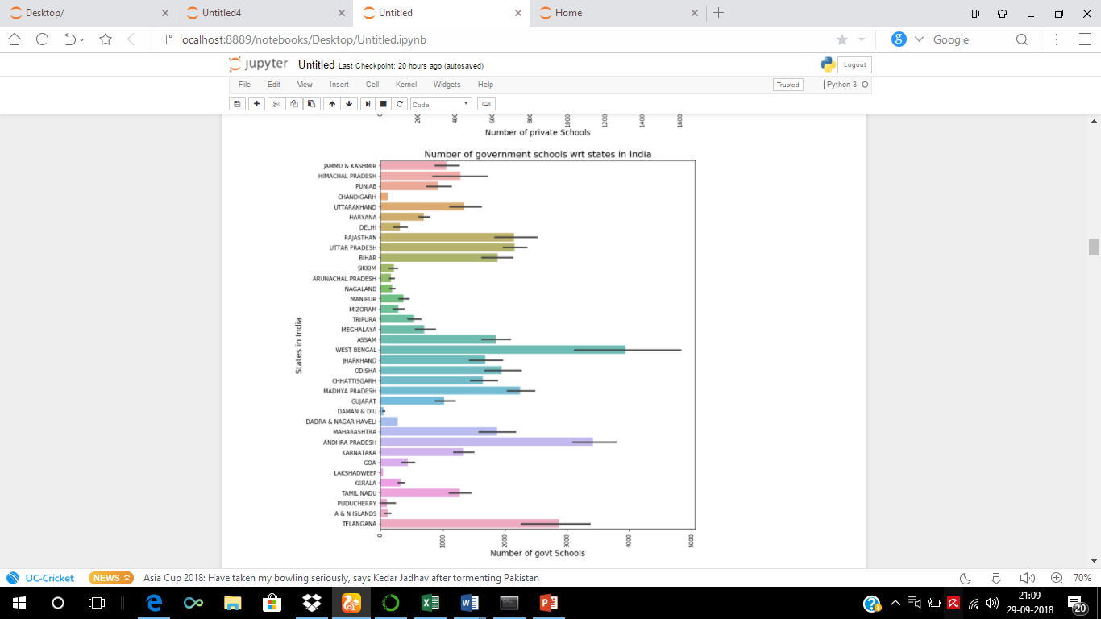

Slide 8
POSSIBLE REASON: Education imparted through private schools is more impactful and sophisticated compared to public schools. The infrastructure and other impeccable facilities provided by these schools ensures a thorough grooming of the students which enables them to be well equipped with the norms of the society.

Slide 9

3.RELATING URBAN POPULATION WITH LITERACY RATE

Slide 10
POSSIBLE REASON: Due to the availability of good teaching staff, course material, technology, and other teaching aids, urban areas can provide education of higher quality. Urban living offers many job opportunities and several career options. Urban areas have better infrastructure and transport facilities. Lacking good staff, funds, learning material, and educational tools, rural areas cannot provide the kind of education that urban areas can. Government funds as well as relief or rehabilitation programs may take longer to reach the rural areas.

Slide 11

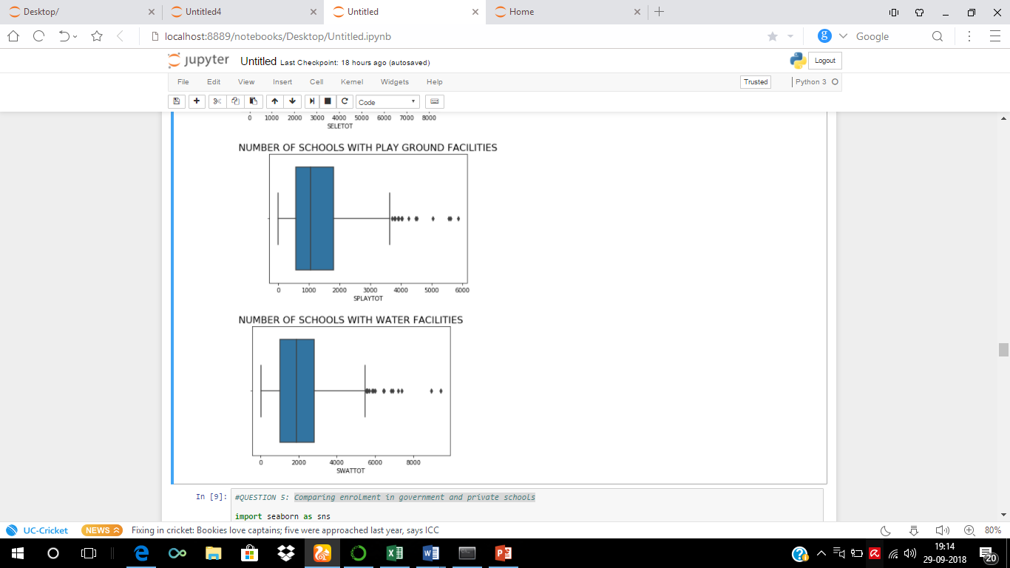
4.LOW NUMBER OF WELL EQUIPPED SCHOOLS IN INDIA!!

Slide 12
Plotting box plots for number of schools with water, electricity and playground facilities for children reveals that relatively fewer schools are well equipped in India.
All three boxplots turned out to be right skewed.

Slide 13
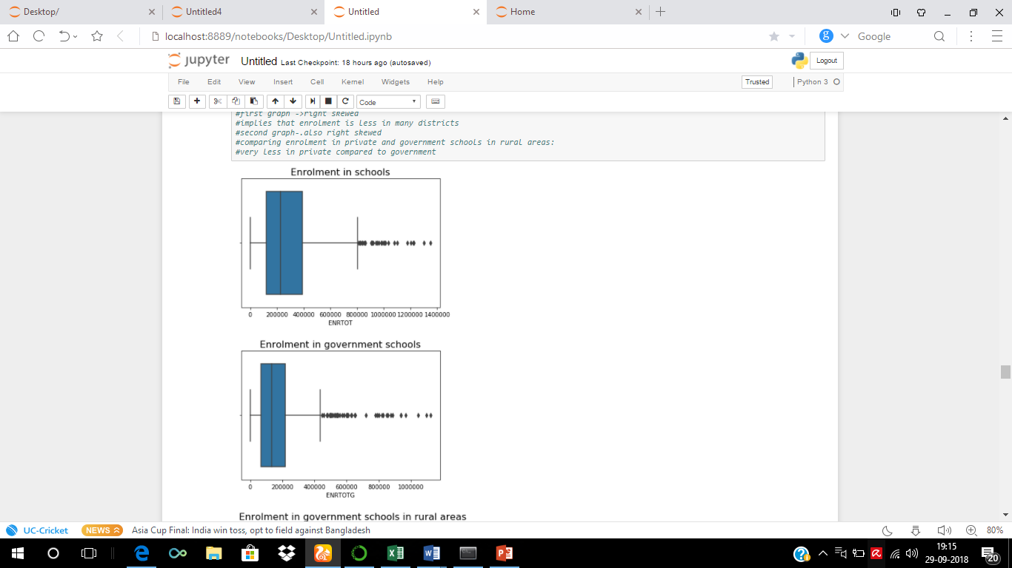

5.Comparing enrolment in government and private schools -WHY GOVERNMENT SCHOOLS ARE MORE POPULAR IN RURAL AREAS?

Slide 14
First graph (boxplot of enrolment in schools in India) is right skewed. This infers that more data points lie to the left of the graph. So, we can say that number of schools with high enrolment is relatively low.
The second graph for enrolment in government schools in India also turned out to be right skewed.
The boxplots for enrolment in government and private schools in rural areas depict that enrolment in government schools is higher that in private in rural areas(because the graph is more right skewed for private)
Because the number of private schools is itself few in number in rural areas. And also, the expenses cannot be met by the working class in rural areas and the mindset of the people isn't accustomed to give enough importance to educate their children at any cost. Hence, we can say that enrollment in private schools is less in rural areas

Slide 15
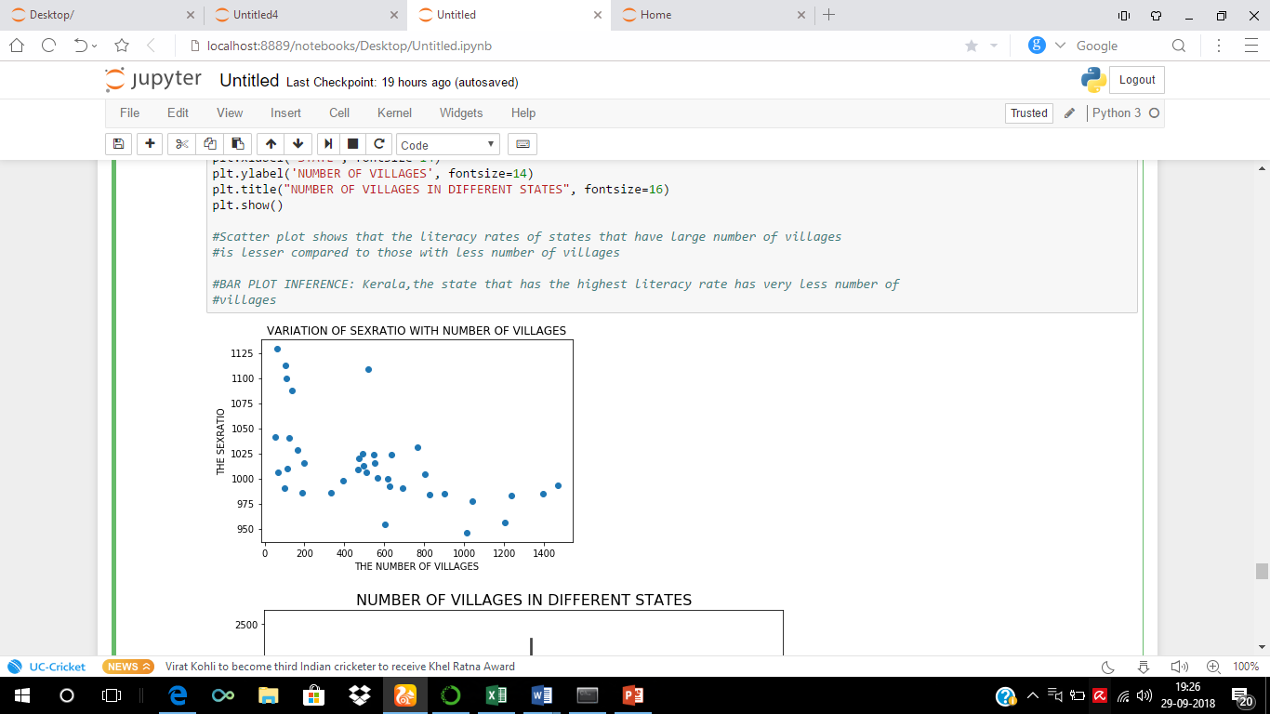
6.DECREASING SEXRATIO WITH INCREASE IN NUMBER OF VILLAGES

Slide 16
This serves as a classic backdrop to reflect the irrational ideas of the society. As the rural areas lack educational benefits, people rely heavily upon their superstitious beliefs which results in female infanticide- one of the core stigmas of the Indian society.
The birth of a girl child is often perceived as a huge liability and are nipped in the bud. This is more prevalent in rural areas as they haven't been exposed to rational thinking and this in turn leads to the decline in the sex ratio.
It is important to change these backward perceptions of people which is possible only through education!

Slide 17
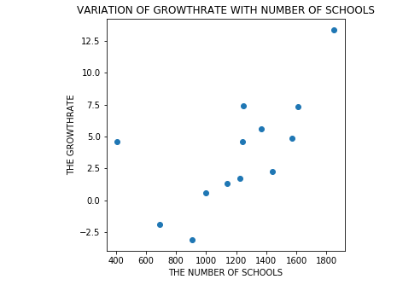
7. INCREASE IN GROWTH RATE WITH NUMBER OF SCHOOLS
More number of schools result in a greater
number of people enrolling their wards to
these schools. This could also influence other
people who haven't realised the
importance of education to enroll their
children to these schools which is bound to
have affordable expenses due to their large
number.

Slide 18
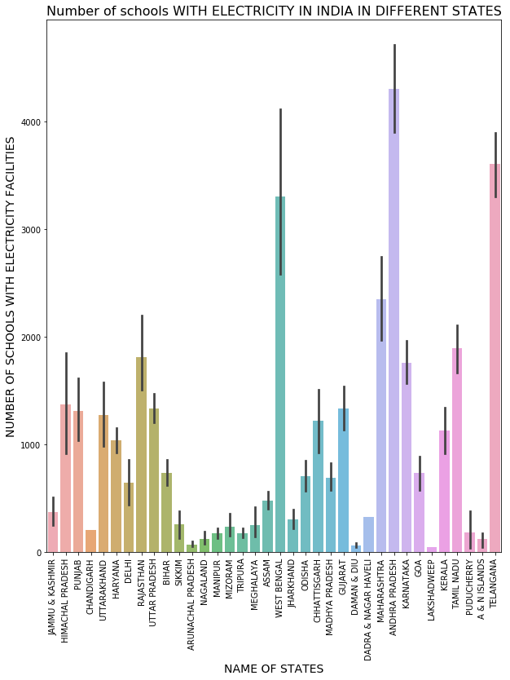
8.WE CANNOT ASSUME THAT BETTER EQUIPPED SCHOOLS GUARANTEE BETTER LITERACY RATES

Slide 19
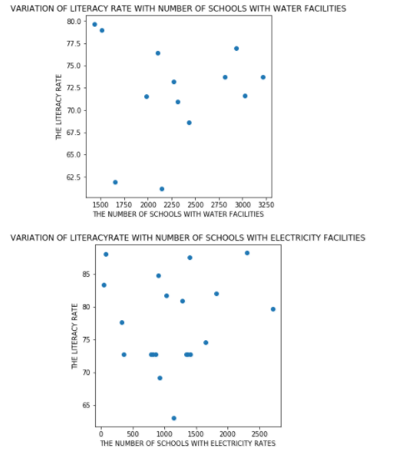
This is an interesting observation we come across in our dataset. Our paradigm of a 'well equipped' school includes better educational facilities, supply of electricity and drinking water, playgrounds etc. But according to the data we have assessed, these well-equipped schools hardly play a role in the increase of literacy rate. It is a convention that better the quality of schools more people are encouraged to enroll their wards. But our dataset contradicts that very fact as the states with extremely well facilitated schools have a literacy rate on the lower end. This gives us a significant insight into the process of data analysis i.e., it is not always possible to estimate an accurate measure of quantities in the dataset and draw possible conclusions based on them because there's always a good probability of going wrong when contradictions such as these occur. Hence assuming that better equipped schools guarantee better literacy rates would be an example for bad visualization.

Slide 20
CONCLUSION
As we have seen from the above analysis, it is possible to understand the crucial characteristics that play a major role in the educational sector of the country. We have also seen contradictory data which requires another thorough sampling of the data lest we go wrong in our conclusions.
We can see that there's a lot of scope for improvement to increase the literacy percentage. For example, imparting free education or also considerably reducing the expenses will surely increase the admission of students in the rural sector. The Right to Free and Compulsory Education Act implemented in 2009 has definitely brought an improvement clearly depicted in this dataset which is from 2015-16.
The introduction of mid-day meal schemes in government schools has encouraged parents in the rural sector to send their children to school. Though there's a need for tweaking the Indian education system, we can surely see a positive scope for boosting the growth rate. With the vast social media influence today, it is feasible to instill the importance of education in everyone's mind and hope for a better future for the progeny as well as the nation.

